Slide 1

“FOREST FIRE PREDICTION USING MACHINE LEARNING” END TERM PRESENTATION
Minor Project Guide
Mr.Vijay Prakash Sharma
(Assistant Professor)
Submitted By
Udayan Khetan & Nimisha Bhadsavale 209302322 209302369
Department of Information Technology
School of Information Technology
Manipal University Jaipur, India
March 2023

Slide 2
CONTENTS
INTRODUCTION
OBJECTIVE
LITERATURE REVIEW
DATASET
METHODOLOGY
MACHINE LEANING MODELS
FUTURE SCOPE
RESULT
CONCLUSION
REFERENCES

Slide 3
INTRODUCTION
Forest fires are a major concern for the environment and human life. It is essential to predict and prevent them before they cause significant damage. Machine learning algorithms have shown promising results in predicting forest fires.
In this presentation, we will discuss how machine learning models can be implemented to predict forest fires.

Slide 4
OBJECTIVE
Effective Forest Fire prediction model that helps to take the necessary steps to prevent forest fire and its negative effects.
Forest fires are major environmental problem that creates ecological destruction in the form of a threatened landscape of natural resources that disrupts the stability of the ecosystem, increases the risk for other natural hazards, and decreases resources such as water that causes global warming and water pollution. Forest Fire Prediction is a key element for controlling such incidents.

Slide 5
LITERATURE REVIEW
PREDICTING FOREST FIRES WITH DIFFERENT DATA MINING TECHNIQUES
International journal of scientific development and research(2020), an approach to predict the burnt area of forest fires using different data mining techniques have been discussed in this paper. Several different data mining techniques includes logistic regression, support vector machine, decision trees and random forest[1]
FOREST FIRE PREDICTION USING ML AND AI
International Journal of Advance Research, Ideas and Innovations in Technology(2021),Forest fire risk prediction method is described in this paper which is based on Support Vector Machines, Logistic Regression, KNN, decision trees, and Random Forest. They proposed a system to predict the percentage of fire occurrence based on various parameters such as temperature, humidity, and oxygen data. The accuracy of SVM and Logistic regression was same but SVM is implemented with the accuracy of 89.47%.[2]

Slide 6
FOREST FIRE PREDICTION MODEL BASED ON AN IMPROVED DYNAMIC CONVOLUTIONAL NEURAL NETWORK
Shaoxiong Zheng, Peng Gao, Weixing Wang and Xiangjun Zou(2022),In this paper DCNN model is created using satellite images which could accurately recognize and classify the risk of a forest fire under natural light conditions.[3]
WILD FIRE PREDICTION USING MACHINE LEARNING MODELS
Nadir Khan, Nowshath K Batcha School of Computing Asia Pacific University of Technology and Innovation (APU) Kuala Lumpur, Malaysia, In this paper KNN classification yields the highest accuracy in predicting whether or not the fire will occur. Model evaluation was performed by calculation some of the performance parameters i.e. Accuracy, Sensitivity, Recall and RMSE. Model evaluation was performed by calculation some of the performance parameters i.e. Accuracy, Sensitivity, Recall and RMSE.[4]

Slide 7
DATASET
The dataset includes 244 instances that regroup a data of two regions of Algeria, namely the Bajaria region located in the northeast of Algeria and the Sidi Bel-abbes region located in the northwest of Algeria.
122 instances for each region.
The period from June 2012 to September 2012.
The dataset includes 11 attributes and 1 output attribute (class)
The 244 instances have been classified into fire (138 classes) and not fire(106 classes) classes. We will classify the data into two types fire and not fire according to the area burnt.

Slide 8
DATASET FEATURES
1. Date : (DD/MM/YYYY) Day, month ('june' to 'september'), year (2012)
Weather data observations
2. Temp : temperature noon (temperature max) in Celsius degrees: 22 to 42
3. RH : Relative Humidity in %: 21 to 90
4. Ws :Wind speed in km/h: 6 to 29
5. Rain: total day in mm: 0 to 16.8
FWI Components
6. Fine Fuel Moisture Code (FFMC) index from the FWI system: 28.6 to 92.5
7. Duff Moisture Code (DMC) index from the FWI system: 1.1 to 65.9
8. Drought Code (DC) index from the FWI system: 7 to 220.4
9. Initial Spread Index (ISI) index from the FWI system: 0 to 18.5
10. Buildup Index (BUI) index from the FWI system: 1.1 to 68
11. Fire Weather Index (FWI) Index: 0 to 31.1
12. Classes: two classes, namely fire and not fire

Slide 9
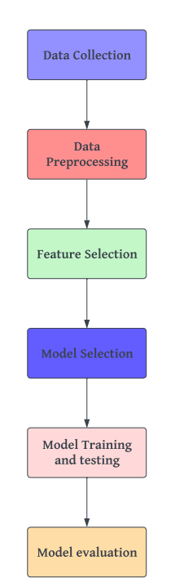
METHODOLGY

Slide 10
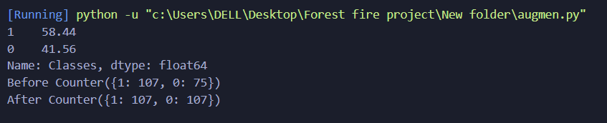
Data Augmentation
Data augmentation is a technique of artificially increasing the training set by creating modified copies of a dataset using existing data. The approach which we have used here is SMOTE(Synthetic Minority Oversampling Technique). It is a technique of simply duplicating examples from the minority class in the training dataset prior to fitting a model. SMOTE works by selecting examples that are close in the feature space, drawing a line between the examples in the feature space and drawing a new sample at a point along that line.

Slide 11
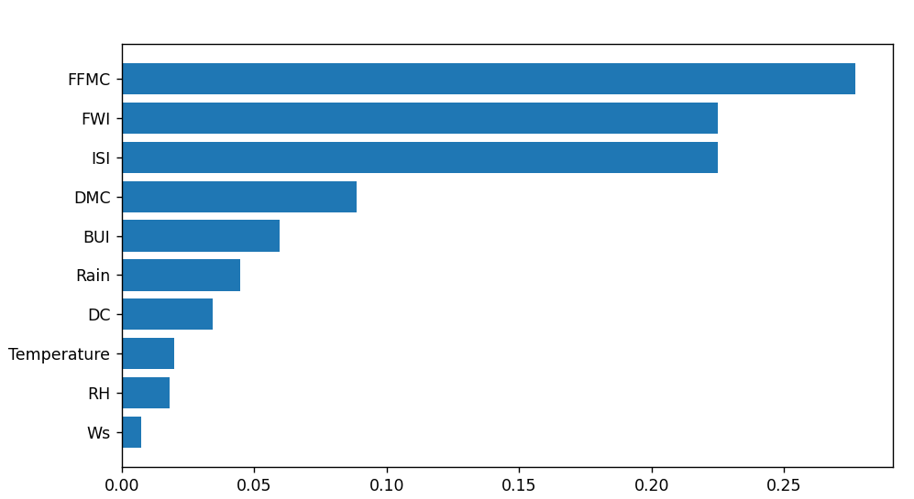
FEATURE SELECTION
We have done feature selection using random forest which comes under the category of embedded methods. Embedded methods combine the qualities of filter and wrapper methods. They are implemented by algorithms that have their own built-in feature selection methods. Some of the benefits of embedded methods are they are highly accurate, generalize better and are interpretable.
We remove Ws attribute as it is least important according to graph shown below.

Slide 12
MACHINE LEARNING MODELS
We are using different classification models for prediction of forest fire. These are:
Logistic Regression
K-Nearest Neighbours
Decision Tree
Random Forest

Slide 13
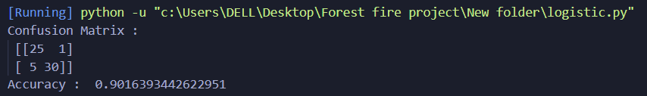
LOGISTIC REGRESSION
Logistic regression is a statistical method for predicting binary classes. The outcome or target variable is binary in nature. It computes the probability of an event occurrence. The relationship between the dependent variable and the independent variable helps it to predict the target variable. To determine their probability and map them to some discrete values, the logistic regression uses sigmoid function.

Slide 14
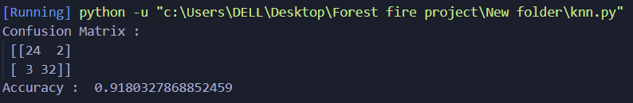
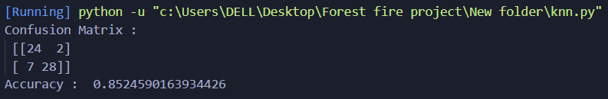
K-Nearest Neighbours
K-NN algorithm assumes the similarity between the new case/data and available cases and put the new case into the category that is most similar to the available categories. K-NN algorithm stores all the available data and classifies a new data point based on the similarity. This means when new data appears then it can be easily classified into a well suite category by using K- NN algorithm.
For K=7
For K=4

Slide 15
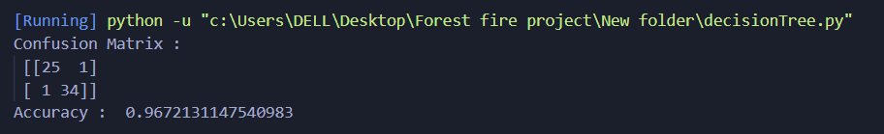
Decision Tree
A decision tree is a flowchart-like structure in which each internal node represents a test on a feature each leaf node represents a class label and branches represent conjunctions of features that lead to those class labels. The paths from root to leaf represent classification rules. Decision trees are
constructed via an algorithmic approach that identifies ways to split a data set based on different conditions.

Slide 16
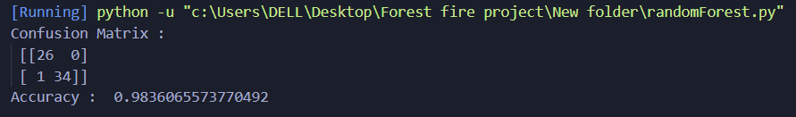
Random Forest
Random forest consists of a large number of individual decision trees that operate as an ensemble. Each individual tree in the random forest spits out a class prediction and the class with the most votes becomes our model’s prediction.

Slide 17
FUTURE SCOPE
We can integrate the trained model into a production environment where it can be used to predict forest fires in real-time.
This project can be further expanded to do better so that the models are better equipped and the effects are better. We may also have a UI built for the application to provide some real-time performance. The workflow of the UI model could be, the user may enter the local and the zip code. Using the zip code, we’ll get latitude and longitude using any APIs and consume the coordinates as parameters, get the weather conditions like peak temperature, min temperature, humidity, wind speed, etc. for a given day

Slide 18
RESULT
After implementation of all the models we find out that Random Forest holds the highest accuracy of 98.36%.

Slide 19
CONCLUSION
Forest fires cause a significant environmental damage while threatening human lives. We implemented a research paper and found Random Forest to work best among KNN, Logistic regression and Decision tree.
The project involves collecting and preprocessing data, selecting important features, training and evaluating machine learning models, deploying the best performance model in a user friendly application and maintaining model over time.

Slide 20
REFERENCES
[1] Madhurima De, Linika Labdhi, Bindu Garg. “Predicting forest fires with different data mining techniques.” IJSDR. 2020.
[2] Adithi M. Shrouthy, Syed Matheen Pasha, Yamini S. R. E., Navya Shree S. ,Lisha U. “Forest fire prediction using ML and AI.” IJARIIT. 2021.
[3] Shaoxiong Zheng, Peng Gao, Weixing Wang and Xiangjun Zou. “Forest fire prediction model based on an improved dynamic convolutional neural network.” MDPI.2022.
[4] Nadir Khan, Nowshath K Batcha. “Wild fire prediction using machine learning models.” JATI. 2021.

Slide 21
Thank you

